Slide 1
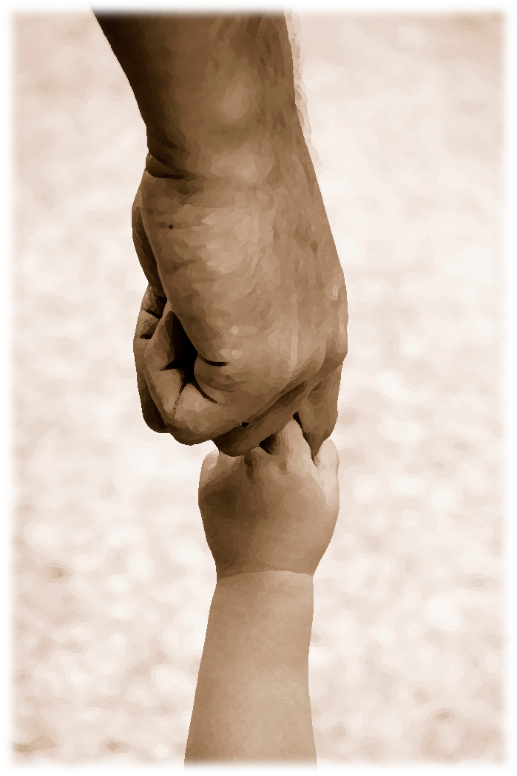
MY FIRST EXPERIENCE IN AKIRACHIX
The welcoming mood.On my arriival, I found the very lady who had interviewed me through video call and this confirmed for me that I was in the right place.I couldnot just find it easy to hide my happiness cause I was like Umamaaaaa!!!! She actually confirmed her kindness to me when she not only gave me a cup of coffee but also to my guardian.She fell free with me and gave an overview plus an adventure in Akirachix and even took me class. It was just ore than a wow!

Slide 2

My first weekend in Akirachix.
Wow! It was a busy day as usual because I woke up as usual and embarked on my class work. Infact it became more tideous compared to the other days since I had a make up class plus fixation of the all assignment.Thanks God I met all my obligations at the end of the day.

Slide 3

My best friends in Akirachix.
Valary- always at my desposal.
Irene-always on my desposal.
Beancah-friendly
Violet-caring
All lovelace members.

Slide 4
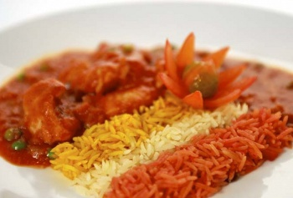
My favourite meal in Akirachix.
Despite of all meals here being awesome,I find my best meal being rice & meat. This is because it has always been my best meal.I enjoy it very much.

Slide 5
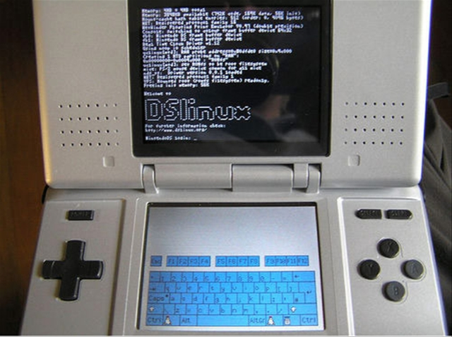
MY best site in Akirachix.
All the sites in Akirachix are wow! But my most favourite place is in class and that’s why I find it uneasy move off it due to its coolness most so when there are no many students.

Slide 6

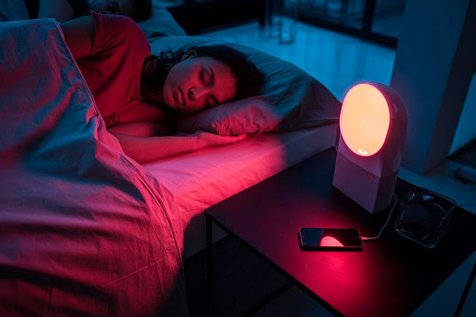
My first night in Akirachix
I took my meal at 8:00pm which was unusual for I could take my dinner at 10:00pm. Though I enjoyed the meal very much.Due to the fact xthat I reported late in school and therefore had to make up the classes, this made me to sleep very late at 1:00am.I just hoped for the best since it was already another day.

